Slide 1
8. Relational Database Design

Slide 2
Goal
To generate a set of relation schemas, that allows us to
Store information without unnecessary redundancy, yet
Also allows us to retrieve information easily
To design schemas in an appropriate normal form
Need information of real-world enterprise information
Some of this information exists in a well-designed E-R diagram, but additional information about the enterprise may be needed as well
Require formal approach to relational database design based on the notion of functional dependencies to define normal forms in terms of functional dependencies and other types of data dependencies

Slide 3
Redundancy and Normalisation
Redundant data
Can be determined from other data in the database
Leads to various problems
INSERT anomalies
UPDATE anomalies
DELETE anomalies
Normalisation
Aims to reduce data redundancy
Redundancy is expressed in terms of dependencies
Normal forms are defined that do not have certain types of dependency

Slide 4
Functional Dependencies
Redundancy is often caused by a functional dependency
A functional dependency (FD) is a link between two sets of attributes in a relation
We can normalise a relation by removing undesirable FDs
A set of attributes, A, functionally determines another set, B, or: there exists a functional dependency between A and B (A → B), if whenever two rows of the relation have the same values for all the attributes in A, then they also have the same values for all the attributes in B.

Slide 5
FDs and Normalisation
We define a set of 'normal forms'
Each normal form has fewer FDs than the last
Since FDs represent redundancy, each normal form has less redundancy than the last
Not all FDs cause a problem
We identify various sorts of FD that do
Each normal form removes a type of FD that is a problem
We will also need a way to remove FDs

Slide 6
Logical Database Design
The process of deciding how to arrange the attributes of the entities in the business environment into database structures, such as the tables of a relational database
This consists of deciding which tables to create, what columns they will contain, as well as the relationships between the tables
The goal is to create well structured tables that properly reflect the company’s business environment

Slide 7
Design Alternative: : Larger Schemas
Suppose instead of having two schemas instructor and department, have single schema: inst dept (ID, name, salary, dept name, building, budget)
Result of a natural join on the relations corresponding to instructor and department
Seems a good idea because some queries can be expressed using fewer joins
Need to repeat the department information (“building” and “budget”) once for each instructor in the department, as many instructors are available in the departments – creating problem of redundancy
If we forget the redundancy problem, and still continue with design there is still another problem
When creating a new department in the university
We cannot represent directly the information concerning a department unless that department has at least one instructor for newly created department
In the old design, the schema department can handle this

Slide 8
Design Alternative: : Smaller Schemas
A real-world database has
A large number of schemas, an even larger number of attributes and the number of tuples can be in the millions or higher
Real university requires that every department must have only one building and one budget value, so two schemas
Department (dept name, building, budget)
Instructor (i_ID, name, dept name, salary)

Slide 9
Design Alternative: : Smaller Schemas
Not all decompositions of schemas are helpful
Consider an extreme case where all schemas consisting of one attribute
No interesting relationships of any kind could be expressed
Consider a less extreme case
Decompose employee schema: employee (ID, name, street, city, salary)
Into two schemas:
employee1 (ID, name) employee2 (name, street, city, salary)

Slide 10
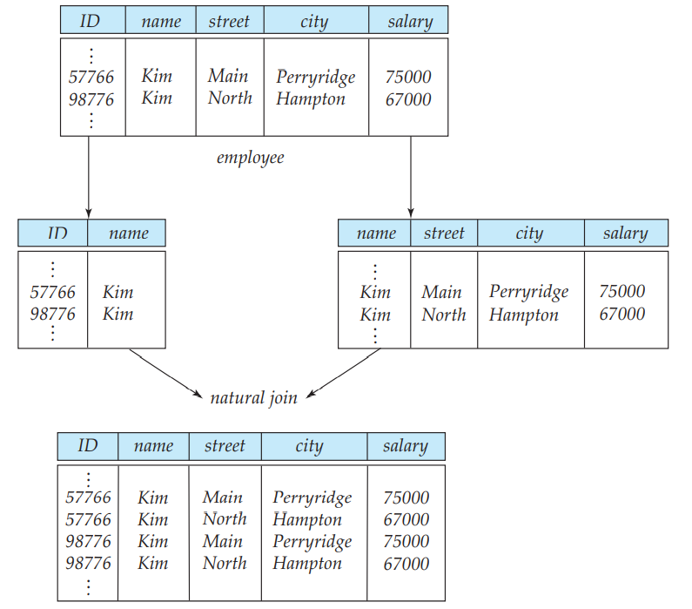
Design Alternative: : Smaller Schemas
If we attempt to regenerate the original tuples using a natural join
Although we have more tuples, we actually have less information
Unable to distinguish which of the Kims’
Decomposition is unable to represent certain important facts about the university employees
Need to avoid such decompositions
Such decompositions known as lossy decompositions
Opposite to this are known as lossless decompositions
Two employees with the same name ‘Kim’
Two original tuples
Two incorrect tuples

Slide 11
Functional Dependency
Real university requires that every department must have only one building and one budget value, so two schemas
Department (dept name, building, budget), Instructor (i_ID, name, dept name, salary)
Need to specify rules such as “each specific value for dept_name corresponds to at most one budget” even in cases where dept_name is not the primary key for the schema in question
A rule that says “if there were a schema (dept name, budget), then dept name is able to serve as the primary key”, specified as a functional dependency: dept_name → budget

Slide 12

Functional Dependency
Dept_Name
Budget
The value of Dept_Name determines the value of Budget
Dept_Name is the determinant
Budget is functionally dependent on Dept_Name

Slide 13
Functional Dependencies
Rules help to recognize situations where a schema ought to be split, or decomposed, into two or more schemas
Finding the right decomposition is much harder for schemas with a large number of attributes and several functional dependencies
To deal with this, required to study a formal methodology

Slide 14
Keys and Functional Dependencies
A database models a set of entities and relationships in the real world
But, there are variety of constraints (rules) on the data also
For example, some of the constraints for a university database are:
Students and instructors are uniquely identified by their ID
Each student and instructor has only one name
Each instructor and student is (primarily) associated with only one department
Each department has only one value for its budget, and only one associated building

Slide 15
Keys and Functional Dependencies
Legal instance of the relation
An instance of a relation that satisfies all such real-world constraints
Legal instance of a database
An instance of a database where all the relation instances are legal instances
Some of the most commonly used types of real-world constraints can be represented formally as Keys (super key, candidate key and primary key), or as functional dependencies

Slide 16
Design Guidelines for Relational Schemas
Informal measures of quality for relation schema design
Semantics of the attributes
Reducing the redundant values in tuples
Disallowing the possibility of generating spurious tuples
These measures are not always independent of one another

Slide 17
Design Guidelines for Relational Schemas
Semantics of the attributes
How the attribute values in a tuple relate to one another
Do not combine attributes from multiple entity types and relationship types into a single relation
A relation schema corresponds to one entity type or one relation

Slide 18
Design Guidelines for Relational Schemas
Reducing the redundant values in tuples
Redundant information in more than one place within a database, creating problems:
Redundant Storage: Some information is stored repeatedly
Update Anomalies: If one copy of such repeated data is updated, an inconsistency is created unless all copies are similarly updated
Insertion Anomalies: It may not be possible to store certain information unless some other, unrelated, information is stored as well
Deletion Anomalies: It may not be possible to delete certain information without losing some other, unrelated, information as well
Design the base relation schemas by replacing the schema so that no insertion, deletion, or modification anomalies are present in the relations
If any anomalies are present, note them clearly and make sure that the programs that update the database will operate correctly

Slide 19
Design Guidelines for Relational Schemas
Disallowing the possibility of generating spurious tuples
Design relation schemas so that they can be joined with equality conditions on attributes that are either primary keys or foreign keys in a way that guarantees that no spurious tuples are generated
Avoid relations that contain matching attributes that are not (foreign key, primary key) combinations, because joining on such attributes may produce spurious tuples

Slide 20
The Data Normalization Process
A methodology for organizing attributes into tables so that redundancy among the non-key attributes is eliminated
The output of the data normalization process is a properly structured relational database

Slide 21
Data Normalization Technique
Input:
All the attributes that must be incorporated into the database
A list of all the defining associations between the attributes (i.e., the functional dependencies)
A means of expressing that the value of one particular attribute is associated with a single, specific value of another attribute
If we know the value of A and we examine the relation that holds this dependency, we will find only one value of B in all of the tuples that have a given value of A, at any moment in time
However, that for a given value of B there may be several different values of A

Slide 22
Functional Dependencies (FDs)
Example: Consider r(A, B) with the following instance of r
On this instance, A → B does NOT hold, but B → A does hold
Reason to identify FDs that hold for all possible values for attributes of a relation
These represent the types of integrity constraints that we need to identify
Such constraints indicate the limitations on the values that a relation can legitimately assume
In other words, they identify the legal instances which are possible
4
1 5
3 7

Slide 23
Functional Dependency - Check
Given the following relation instance.
X Y Z
1 4 2
1 5 3
1 6 3
3 2 2
Which of the following functional dependencies are satisfied by the instance?
X -> Y (b) Y -> Z (c) X -> Z (d) Y -> X (e) Z -> X (f) Z -> Y
In option (a), its given X->Y, it means that the value of X uniquely determines the value of Y. But, here the value 1 of X, gives three different values of Y i.e. 4, 5 and 6. Therefore this FD is not satisfied by the instance.
(a) X -> Y (b) Y -> Z (c) X -> Z (d) Y -> X (e) Z -> X (f) Z -> Y

Slide 24
Functional Dependency - Check
Given the following relation instance.
X Y Z
1 4 2
1 5 3
1 6 3
3 2 2
Which of the following functional dependencies are satisfied by the instance?
XY -> Z and Z -> Y (b) YZ -> X and X -> Z
(c) YZ -> X and Y -> Z (d) XZ -> Y and Y -> X

Slide 25
Functional Dependency - Check
X Y Z
1 4 2
1 5 3
1 6 3
3 2 2
Option (a): XY -> Z and Z -> Y
Given Z->Y, it means that the value of Z uniquely determines the value of Y. But here the value 2 of Z, gives two different values of Y i.e. 4 and 2. Therefore this FD is not satisfied by the instance.
Option (b): YZ -> X and X -> Z
Given X->Z, it means that the value of X uniquely determines the value of Z. But here the value 1 of X, gives two different values of Z i.e. 2 and 3. Therefore this FD is not satisfied by the instance.

Slide 26
Functional Dependency - Check
X Y Z
1 4 2
1 5 3
1 6 3
3 2 2
Option (c): YZ -> X and Y -> Z
Given Y-> Z, here the value of Y uniquely determines the value of Z. Therefore this FD is satisfied by the instance.
Now take FD YZ-> X, here (4,2), (5,3), (6,3), (2,2) uniquely determine the value of X. Therefore this FD (YZ->X) is satisfied by the instance.
Option (d): XZ -> Y and Y -> X
Given Y->X, here the value of Y uniquely determines the value of X. Therefore this FD is satisfied by the instance.
Now take FD XZ->Y, here (1,3) cannot uniquely determine the value of Y. (1,3) gives two values for Y i.e. 5 and 6. Therefore this FD (XZ->Y) is not satisfied by the instance.

Slide 27
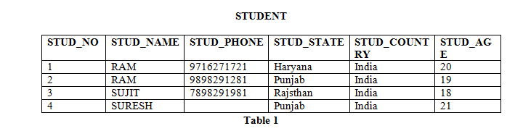
Functional Dependency
Possible FDs
STUD_NO is unique for each student
STUD_NO 🡪 STUD_NAME
STUD_NO 🡪 STUD_PHONE
STUD_NO 🡪 STUD_STATE
STUD_NO 🡪 STUD_COUNTRY
STUD_NO 🡪 STUD_AGE
STUD_STATE 🡪 STUD_COUNTRY
Check FD: STUD_STATE 🡪 STUD_COUNTRY ?
Yes, possible FD, as if two records have same STUD_STATE, they will have same STUD_COUNTRY as well
Check FD: STUD_NAME 🡪 STUD_ADDR ?
No, Not possible, as two students’ having same name, determines two different States.

Slide 28
Functional Dependency
FDs set: Set of all FDs present in the relation
{STUD_NO 🡪 STUD_NAME,
STUD_NO 🡪 STUD_PHONE
STUD_NO 🡪 STUD_STATE
STUD_NO 🡪 STUD_COUNTRY
STUD_NO 🡪 STUD_AGE
STUD_STATE 🡪 STUD_COUNTRY
}

Slide 29
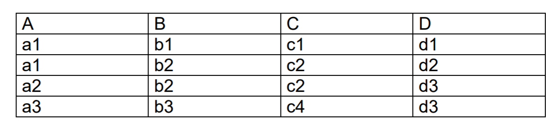
Functional Dependency
FD Set: ?
{
C🡪B
AB🡪C
AB🡪D
CD🡪B
}
Check FDs?
A🡪B
(Violating Tuples: 1 and 2)
B🡪A
(Violating Tuples: 2 and 3)
D🡪C
(Violating Tuples: 3 and 4)

Slide 30
Functional Dependencies (FDs)
A functional dependency is trivial if it is satisfied by all instances of a relation
Example:
ID, name → ID
name → name
In general, α → β is trivial if β ⊆ α
Although trivial Fds are valid, they offer no additional information about integrity constraints for the relation
As far as normalization is concerned, trivial Fds are ignored

Slide 31
Closure of a Set of Functional Dependencies
Given a set F of functional dependencies, there are certain other functional dependencies that are logically implied by F which can be inferred or deduced from the Fds in F
For example: If we know that Kristi is older than Debi and that Debi is older than Traci, we are able to infer that Kristi is older than Traci.
How did we make this inference?
Without thinking about it or maybe knowing about it, we utilized a transitivity rule to make this inference: Kristi > Debi, Debi > Traci, then Kristi > Traci

Slide 32
Closure of a Set of Functional Dependencies
For example: If A → B and B → C, then we can infer that A → C
The set of all functional dependencies logically implied by F is the closure of F
We denote the closure of F by F⁺
F⁺ is a superset of F

Slide 33
Closure of a Set of Functional Dependencies
To infer {A → C} from {{A → B}, {B → C}}
Require a set of inference rules to infer the set of Fds in F+
Armstrong provided a set of inference rules

Slide 34
Closure of a Set of Functional Dependencies
We can find F^{+,} the closure of F, by repeatedly applying Armstrong’s Axioms:
Main (sufficient set of inference rules for generating closure set of FDs)
if β ⊆ α, then α → β (Reflexivity)
if α → β, then γ α → γ β (Augmentation)
if α → β, and β → γ, then α → γ (Transitivity)
Others (Can be derived from main)
if α → γ β , then α → γ and α → β (Projection)
if α → γ and α → β, then α → γ β (Additive)
if α → β, and β γ→ l, then αγ → l (Pseudo Transitivity)
These rules are
sound (generate only functional dependencies that actually hold), and
complete (generate all functional dependencies that hold)

Slide 35
Closure of a Set of Functional Dependencies
R = (A, B, C, G, H, I) F = { A → B A → C CG → H CG → I B → H}
Some members of F⁺ : {A → H, AG → I} ?
A → H
Achieved by:
1) transitivity from A → B
2) transitivity from B → H

Slide 36
Closure of a Set of Functional Dependencies
R = (A, B, C, G, H, I) F = { A → B A → C CG → H CG → I B → H}
Some members of F⁺ : {A → H, AG → I} ?
AG → I
Achieved by
1) augmenting A → C with G, to get AG → CG
2) transitivity with CG → I

Slide 37
Closure of a Set of Functional Dependencies
Given R = (A,B,C,D,E,F,G,H, I, J) and
F = {AB → E, AG → J, BE → I, E → G, GI → H}
Does F+ : {AB → GH} ?

Slide 38
Closure of a Set of FDs
if β ⊆ α, then α → β (Reflexivity)
if α → β, then γ α → γ β (Augmentation)
if α → β, and β → γ, then α → γ (Transitivity)
if α → γ β , then α → γ and α → β (Projection)
if α → γ and α → β, then α → γ β (Additive)
Given R = (A,B,C,D,E,F,G,H, I, J) and F = {AB → E, AG → J, BE → I, E → G, GI → H}, Does F+: {AB → GH}?
Proof
1. AB → E, given in F
2. AB → AB, reflexive rule IR1
3. AB → B, projective rule IR4 from step 2
4. AB → BE, additive rule IR5 from steps 1 and 3
5. BE → I, given in F
6. AB → I, transitive rule IR3 from steps 4 and 5
7. E → G, given in F
8. AB → G, transitive rule IR3 from steps 1 and 7
9. AB → GI, additive rule IR5 from steps 6 and 8
10. GI → H, given in F
11. AB → H, transitive rule IR3 from steps 9 and 10
12. AB → GH, additive rule IR5 from steps 8 and 11
– proven

Slide 39
Procedure for Computing F⁺
To compute the closure of a set of functional dependencies F:
F ⁺ = F repeat for each functional dependency f in F⁺ apply reflexivity and augmentation rules on f add the resulting functional dependencies to F ⁺ for each pair of functional dependencies f₁and f₂ in F ⁺ if f₁ and f₂ can be combined using transitivity then add the resulting functional dependency to F ⁺ until F ⁺ does not change any further
NOTE: We shall see an alternative procedure for this task later

Slide 40
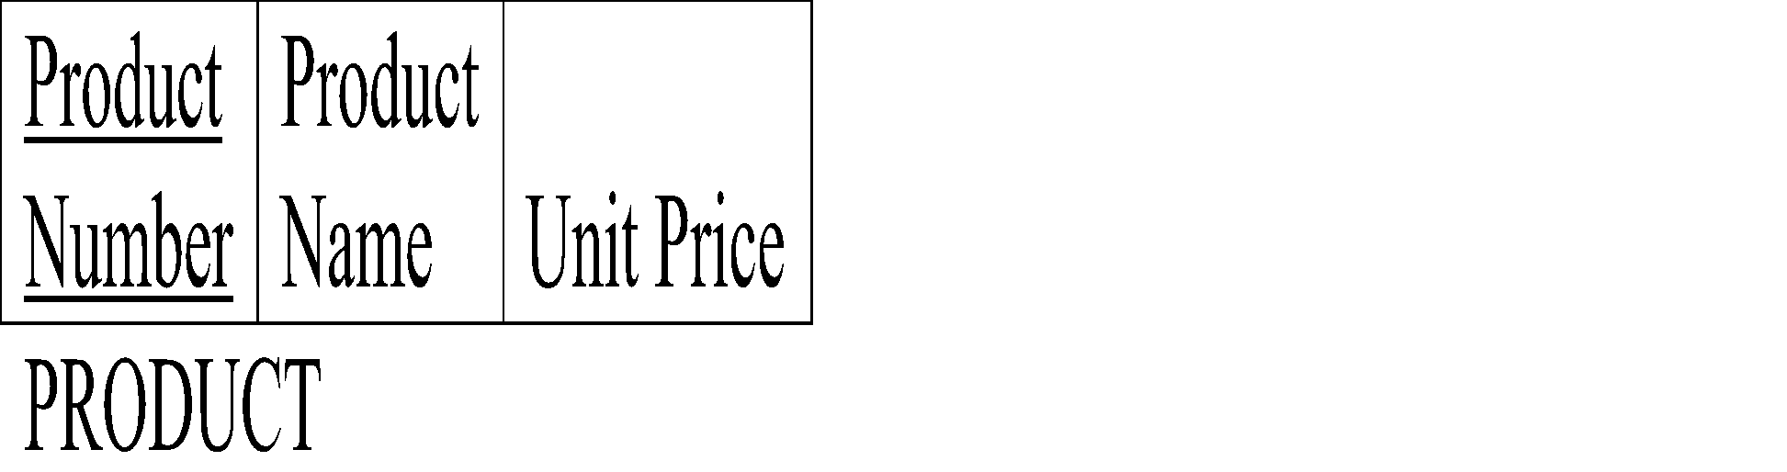

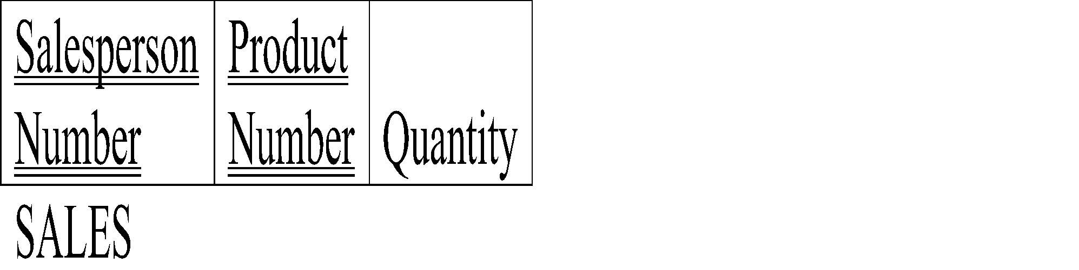


Hardware Company Database
Salesperson is working at an office. Salesperson sells the products to the customers.

Slide 41
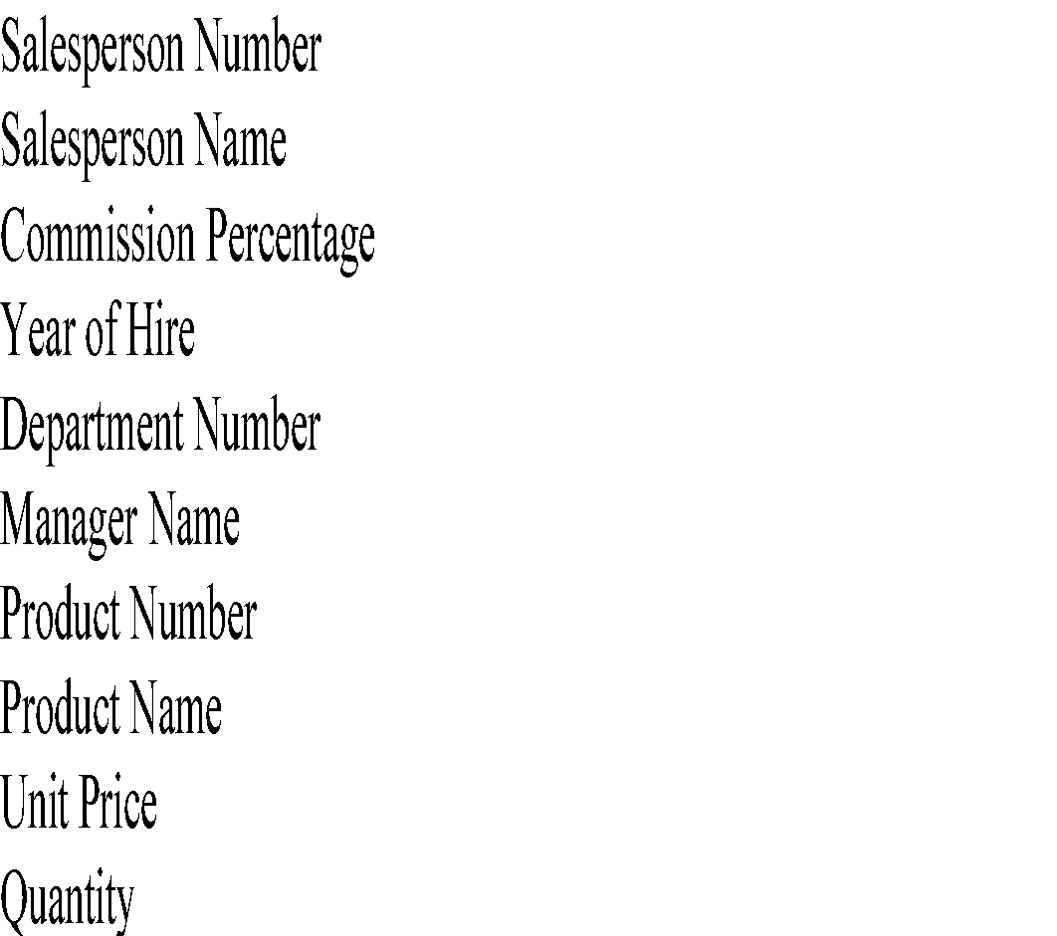
Hardware Company: SALESPERSON and PRODUCT
List out the functional dependencies.

Slide 42
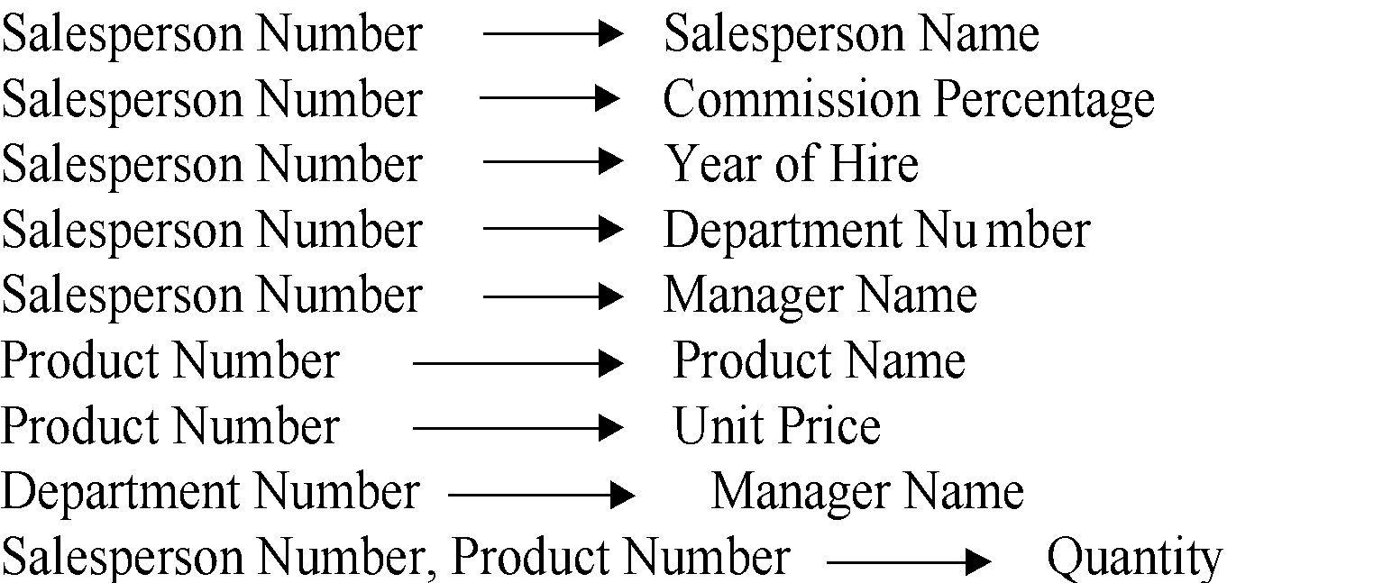

Hardware Company: SALESPERSON and PRODUCT

Slide 43
Functional Dependency - Advantages
Removes data redundancy where the same values should not be repeated at multiple locations in the same database table
Maintains the quality of data in the database
Allows clearly defined meanings and constraints of databases
Helps in identifying bad designs of the database
Expresses the facts about the database design

Slide 44
Attributes Closure
An attribute B is functionally determined by α, if α → B
To test whether a set α is a super key
Devise an algorithm for computing the set of attributes functionally determined by α
Using FDs
One way of doing this is to compute F⁺, take all functional dependencies with as the left-hand side, and take the union of the right-hand sides of all such dependencies
Expensive, since F⁺ can be large
Solution
Attributes Set Closure

Slide 45
Uses of Attributes Set Closure
Testing for super key:
To test if α is a super key, compute α^{+,} and check if α⁺ contains all attributes of R
Testing functional dependencies
To check if a functional dependency α → β holds (or, in other words, is in F⁺), just check if β ⊆ α⁺
Compute α⁺ by using attribute closure, and then check if it contains β
Is a simple and cheap test, and very useful
Computing closure of F
For each γ ⊆ R, find the closure γ⁺, and for each S ⊆ γ⁺, output a functional dependency γ → S

Slide 46
Closure of Attribute Sets
Given a set of attributes α, define the closure of α under F (denoted by α⁺) as the set of attributes that are functionally determined by α under F
Algorithm to compute α⁺, the closure of α under F result := α; while (changes to result) do for each β → γ in F do begin if β ⊆ result then result := result ∪ γ end

Slide 47
Example of Attribute Set Closure
R = (A, B, C, G, H, I)
F = {A → B, A → C, CG → H, CG → I, B → H}
(AG)⁺ = ?
1. result = AG
2. result = ABCG (A → B and A ⊆ AG, so result U= B,
A → C and A ⊆ AG, so result U= C)
3. result = ABCGH (CG → H and CG ⊆ AGBC, so result U= H)
result = ABCGHI (CG → I and CG ⊆ AGBCH, so result U= I)
No new attributes are added to result after this, and the algorithm terminates

Slide 48
Uses of the Attribute Closure
To test if α is a superkey, we compute α+, and check if α+ contains all attributes in R
We can check if a functional dependency α → β holds (or, in other words, is in F+), by checking if β ⊆ α+. That is, we compute α+ by using attribute closure, and then check if it contains β
It gives us an alternative way to compute F+: For each γ⊆ R, we find the closuer γ+ and for each S ⊆ γ +, we output a functional dependency γ → S.

Slide 49
Attribute Set Closure
FDs set:{
STUD_NO 🡪 STUD_NAME,
STUD_NO 🡪 STUD_PHONE
STUD_NO 🡪 STUD_STATE
STUD_NO 🡪 STUD_COUNTRY
STUD_NO 🡪 STUD_AGE
STUD_STATE 🡪 STUD_COUNTRY
}
Attribute Closure:
(STUD_NO)+ = {
STUD_NO,
STUD_NAME,
STUD_PHONE,
STUD_STATE,
STUD_COUNTRY,
STUD_AGE
}
(STUD_STATE)+ = {STUD_STATE, STUD_COUNTRY}

Slide 50
Find Candidate Keys and Super Keys using Attribute Closure
If attribute closure of an attribute set contains all attributes of relation, the attribute set will be super key of the relation
If no subset of this attribute set can functionally determine all attributes of the relation, the set will be candidate key as well
For Example, using FD set of STUDENT table ,
(STUD_NO, STUD_NAME)+ =
{STUD_NO, STUD_NAME, STUD_PHONE, STUD_STATE, STUD_COUNTRY, STUD_AGE}
(STUD_NO)+ =
{STUD_NO, STUD_NAME, STUD_PHONE, STUD_STATE, STUD_COUNTRY, STUD_AGE}
(STUD_NO, STUD_NAME) will be super key but not candidate key because its subset (STUD_NO)+ is equal to all attributes of the relation
So, STUD_NO will be a candidate key
FDs set:{ STUD_NO 🡪 STUD_NAME,
STUD_NO 🡪 STUD_PHONE
STUD_NO 🡪 STUD_STATE
STUD_NO 🡪 STUD_COUNTRY
STUD_NO 🡪 STUD_AGE
STUD_STATE 🡪 STUD_COUNTRY }

Slide 51
Example of Attribute Set Closure
Let R= (A, B, C, D, E, F) be a relation Relation with the following dependencies: C->F, E->A, EC->D, A->B. Which of the following is a key for R?
(a) CD (b) EC
(c) AE (d) AC
FDs: C->F, E->A, EC->D, A->B Find closure set for CD. X = CD = CDF {C->F}
No more attributes can be added to X. Hence closure set of CD = CDF
Find closure set for EC. X = EC = ECF {C->F} = ECFA {E->A} = ECFAD {EC->D} = ECFADB {A->B}
Closure set of EC covers all the attributes of the relation R.
If any closure covers all the attributes of the relation R then that is the key.

Slide 52
Attribute Closure
Given the relation Relation R = {E, F, G, H, I, J, K, L, M, M} and the set of functional dependencies {{E, F} -> {G}, {F} -> {I, J}, {E, H} -> {K, L}, K -> {M}, L -> {N} on R.
What is the key for R?: i) {E, F}, ii) {E, F, H}, iii) {E, F, H, K, L}, iv) {E}

Slide 53
Attribute Closure
Given the relation Relation R = {E, F, G, H, I, J, K, L, M, M} and the set of functional dependencies {{E, F} -> {G}, {F} -> {I, J}, {E, H} -> {K, L}, K -> {M}, L -> {N} on R.
What is the key for R?: i) {E, F}, ii) {E, F, H}, iii) {E, F, H, K, L}, iv) {E}
Now, find the attribute closure of all given options, receive: {E,F}+ = {EFGIJ}
{E,F,H}+ = {EFHGIJKLMN}
{E,F,H,K,L}+ = {{EFHGIJKLMN}
{E}+ = {E}
{EFH}+ and {EFHKL}+ results in set of all attributes, but EFH is minimal. So it will be candidate key. So correct option is (ii).

Slide 54
Canonical Cover
Whenever a user updates the database, the system must check whether any of the functional dependencies are getting violated in this process
If there is a violation of dependencies in the new database state, the system must roll back
Working with a huge set of functional dependencies can cause unnecessary added computational time
This is where the canonical cover comes into play
A canonical cover of a set of functional dependencies F is a simplified set of functional dependencies that has the same closure as the original set F

Slide 55
Canonical Cover
A Canonical Cover for a set of functional dependencies F is another set of functional dependencies Fc such that all the functional dependencies in F logically imply all the functional dependencies in Fc and vice versa
Fc should meet the following requirements;
1. F should logically imply all FDs in Fc, [F = Fc]
2. Fc should logically imply all FDs in F,
3. Functional dependencies of Fc should not contain any Extraneous attribute.
4. The left side of all the functional dependencies in Fc should be unique.

Slide 56
Canonical Cover
So, a Canonical cover Fc is a minimal set of FDs that is equivalent to F, and have no redundant FDs or redundant attributes as part of FDs
In other words, every functional dependency of Fc is very much needed and it is as small as possible when compared to the size of F

Slide 57
Canonical Cover
Example:
Redundant Functional Dependency:
A → C is redundant in {A → B, B → C, A → C}
Here, A → B and B → C will automatically include A → C as a result of Transitivity
Hence, we do not need to check whether C is uniquely determined by A or not [in other words, A uniquely determines C or not]. Hence, A → C is redundant
And, the set of functional dependencies {A → B, B → C} is semantically equivalent to given set of functional dependencies {A → B, B → C, A → C}

Slide 58
Canonical Cover Algorithm
ALGORITHM CanonicalCover (FD set F)
BEGIN
REPEAT UNTIL STABLE
1. Wherever possible, apply UNION rule from Armstrong’s Axioms
(e.g., A → BC, A → CD becomes A → BCD)
2. Remove “extraneous attributes”, if any, from every FD
(e.g., AB→C, A→B becomes A→B, B→C i.e., A is extraneous in AB→C)
END

Slide 59
Canonical Cover
For example: A → C is redundant in: {A → B, B → C, A → C}
Parts of a functional dependency may be redundant
E.g.: on RHS: {A → B, B → C, A → CD} can be simplified to
{A → B, B → C, A → D}
E.g.: on LHS: {A → B, B → C, AC → D} can be simplified to
{A → B, B → C, A → D}

Slide 60
Extraneous Attributes
Redundant Attributes or Redundant Part of Set of Attributes:
Attribute C is redundant on the Right Hand Side (RHS) of FD
A → CD in {A → B, B → C, A → CD}
Here, C is already determined by B
Hence, we do not need to include in another FD to check the dependency
So, the given set of functional dependencies can be simplified as
{A → B, B → C, A → D}
And, this is equivalent

Slide 61
Extraneous Attributes
Redundant Attributes or Redundant Part of Set of Attributes:
Attribute C is redundant on the Left Hand Side (LHS) of FD
AC → D in {A → B, B → C, AC → D}
Here, if we know A, intuitively we know C as well through Transitivity rule
Hence, A → D is suffice to represent. So, the given set of functional dependencies can be simplified as
{A → B, B → C, A → D}
And, this is equivalent to the given set of FDs

Slide 62
Extraneous Attributes - Algorithm
Case 1 (LHS): To find if an attribute A in α is extraneous or not. That is, to test if an attribute of Left Hand Side of a functional dependency is Extraneous or not.
Step 1: Find ({α} – A)⁺ using the dependencies of F.
Step 2: If ({α} – A)⁺ contains all the attributes of β, then A is extraneous.
Case 2 (RHS): To find if an attribute A in β is extraneous or not. That is, to test if an attribute of Right Hand Side of a functional dependency is Extraneous or not.
Step 1: Find α⁺ using the dependencies in F’ where F’ = (F – {α → β}) U { α → (β – A) }.
Step 2: If α⁺ contains A, then A is extraneous.

Slide 63
Finding Extraneous Attributes
Example 1 for LHS:
Given F = {P→Q, PQ→R}. Is Q extraneous in PQ→R?
Looking for a LHS attribute, Hence, let us use Case 1 discussed above
Step 1: Find ({α} – A)⁺ using the dependencies of F.
Here, α is PQ. So find (PQ – Q)⁺, i.e., P+ (closure of P).
From F, if you know P, then you know Q (from P→Q).
If you know both P and Q then you know R (from PQ→R).
Hence, the closure of P is PQR.
Step 2: If ({α} – A)⁺ contains all the attributes of β, then A is extraneous.
(PQ – Q)⁺ contains R. Hence, Q is extraneous in PQ→R.

Slide 64
Finding Extraneous Attributes
Example 2 for RHS:
Given F = {P→QR, Q→R}. Is R extraneous in P→QR?
Looking for a RHS attribute. Hence, let us use the Case 2 given above.
Step 1: Find α⁺ using the dependencies in F’ where F’ = (F – {α → β}) U { α → (β – A) }.
Let us find F’ as stated above.
F’ = (F – {α → β}) U { α → (β – A) } = ({P→QR, Q→R} – {P→QR}) U {P→(QR-R)}
= ({Q→ R} U {P→Q})
F’ = {Q→R, P→Q}
Here, α is P. So find (P)⁺, i.e., closure of P using the F’ which we found.
From F’, if you know P, then you know Q (from P→Q).
If you know Q then you know R (from Q→R).
Hence, the closure of P is PQR.
Step 2: If α⁺ contains A, then A is extraneous.
P+ contains R. Hence, R is extraneous in P→QR.

Slide 65
Extraneous Attributes
Example: Given F = {A → C, AB → C }
B is extraneous in AB → C ?
{A → C, AB → C} logically implies A → C (I.e. the result of dropping B from AB → C).
Example: Given F = {A → C, AB → CD}
C is extraneous in AB → CD ?
Since AB → C can be inferred even after deleting C

Slide 66
Computing a Canonical Cover
R = (A, B, C) and F = {A → BC, B → C, A → B, AB → C}

Slide 67
Canonical Cover Algorithm - Revise
ALGORITHM CanonicalCover (FD set F)
BEGIN
REPEAT UNTIL STABLE
1. Wherever possible, apply UNION rule from Armstrong’s Axioms
(e.g., A → BC, A → CD becomes A → BCD)
2. Remove “extraneous attributes”, if any, from every FD
(e.g., AB→C, A→B becomes A→B, B→C i.e., A is extraneous in AB→C)
END
Note: Union rule may become applicable after some extraneous attributes have been deleted, so it has to be re-applied

Slide 68
Computing a Canonical Cover
R = (A, B, C) and F = {A → BC, B → C, A → B, AB → C}
Combine A → BC and A → B into A → BC
Set is now {A → BC, B → C, AB → C}
A is extraneous in AB → C
Check if the result of deleting A from AB → C is implied by the other dependencies
Yes: in fact, B → C is already present!
Set is now {A → BC, B → C}
C is extraneous in A → BC
Check if A → C is logically implied by A → B and the other dependencies
Yes: using transitivity on A → B and B → C.
Can use attribute closure of A in more complex cases
The canonical cover is: A → B, B → C

Slide 69
Normalization
The process which allows you to remove redundant data within your database.
The applications required to maintain the database are simpler.
This involves restructuring the tables to successively meeting higher forms of Normalization.
A design that has a lower normal form than another design has more redundancy. Uncontrolled redundancy can lead to data integrity problems.
A properly normalized database should have the following characteristics
Scalar values in each fields.
Absence of redundancy.
Minimal use of null values.
Minimal loss of information.

Slide 70
Levels of Normalization
Levels of normalization based on the amount of redundancy in the database.
Various levels of normalization are:
First Normal Form (1NF)
Second Normal Form (2NF)
Third Normal Form (3NF)
Boyce-Codd Normal Form (BCNF)
Fourth Normal Form (4NF)
Fifth Normal Form (5NF)
Domain Key Normal Form (DKNF)
Redundancy
Number of Tables
Complexity
Most databases should be 3NF or BCNF in order to avoid the database anomalies.

Slide 71
Levels of Normalization
1NF
2NF
3NF
4NF
5NF
DKNF
Each higher level is a subset of the lower level
The data normalization process is progressive.
For example, if a group of tables is in second normal form, it is also in first normal form.

Slide 72
Normalization
With the exception of 1NF, all these normal forms are based on Functional dependencies among the attributes of a table.
A group of tables is said to be in a particular normal form if every table in the group is in that normal form.

Slide 73
First Normal Form
A relation is in 1NF, if all values stored in the relation are single-valued and atomic (as opposed to list of values).
1NF places restrictions on the structure of relations. Values must be simple.
All the fields contain only scalar values
Having scalar values also means that all instances of a record type must contain the same number of fields.

Slide 74
First Normal Form (1NF)
Example: 1 NF?
ISBN
Title
AuName
AuPhone
PubName
PubPhone
Price
0-321-32132-1
Balloon
Sleepy, Snoopy, Grumpy
321-321-1111, 232-234-1234, 665-235-6532
Small House
714-000-0000
$34.00
0-55-123456-9
Main Street
Jones, Smith
123-333-3333, 654-223-3455
Small House
714-000-0000
$22.95
0-123-45678-0
Ulysses
Joyce
666-666-6666
Alpha Press
999-999-9999
$34.00
1-22-233700-0
Visual Basic
Roman
444-444-4444
Big House
123-456-7890
$25.00
Author and AuPhone columns are not scalar
Not 1NF
A table not in first normal form is called un normalized

Slide 75
1NF - Decomposition
Place all items that appear in the repeating group in a new table
Designate a primary key for each new table produced (the primary key of the original table concatenated with one or more data items from the new table)
Duplicate in the new table the primary key of the table from which the repeating group was extracted or vice versa.
Example 1: Converted to 1NF
Primary Key
Primary Key
ISBN
Title
PubName
PubPhone
Price
ISBN
AuName
AuPhone
0-321-32132-1
Balloon
Small House
714-000-0000
$34.00
0-321-32132-1
Sleepy
321-321-1111
0-55-123456-9
Main Street
Small House
714-000-0000
$22.95
0-321-32132-1
Snoopy
232-234-1234
0-123-45678-0
Ulysses
Alpha Press
999-999-9999
$34.00
0-321-32132-1
Grumpy
665-235-6532
1-22-233700-0
Visual Basic
Big House
123-456-7890
$25.00
0-55-123456-9
Jones
123-333-3333
0-55-123456-9
Smith
654-223-3455
0-123-45678-0
Joyce
666-666-6666
1-22-233700-0
Roman
444-444-4444
Notes:
1. The designated key will be the primary key of the original table concatenated with one or more data items from the new table.
For the first table the primary key is ISBN
For the second table the primary key is ISBN + Author Name

Slide 76
First Normal Form
The relation is not in 1NF
EmpNum
EmpPhone
EmpDegrees
123
233-9876
333
233-1231
BA, BSc, PhD
679
233-1231
BSc, MSc
EmpDegrees is a multi-valued field:
employee 679 has two degrees: BSc and MSc
employee 333 has three degrees: BA, BSc, PhD

Slide 77
First Normal Form
EmpNum
EmpPhone
EmpDegrees
123
233-9876
333
233-1231
BA, BSc, PhD
679
233-1231
BSc, MSc
To obtain 1NF relations
Without loss of information, replace the above with two relations - see next slide

Slide 78
First Normal Form
EmployeeDegree
Employee
EmpNum
EmpDegree
EmpNum
EmpPhone
333
BA
123
233-9876
333
BSc
333
233-1231
333
PhD
679
233-1231
679
BSc
679
MSc
An outer join between Employee and EmployeeDegree will produce the information we saw before

Slide 79
Normalisation to 1NF
Unnormalised
Module Dept Lecturer Texts
M1 D1 L1 T1, T2
M2 D1 L1 T1, T3
M3 D1 L2 T4
M4 D2 L3 T1, T5
M5 D2 L4 T6
1NF
Module Dept Lecturer Text
M1 D1 L1 T1
M1 D1 L1 T2
M2 D1 L1 T1
M2 D1 L1 T3
M3 D1 L2 T4
M4 D2 L3 T1
M4 D2 L3 T5
M5 D2 L4 T6

Slide 80
Problems in 1NF
1NF
Module Dept Lecturer Text
M1 D1 L1 T1
M1 D1 L1 T2
M2 D1 L1 T1
M2 D1 L1 T3
M3 D1 L2 T4
M4 D2 L3 T1
M4 D2 L3 T5
M5 D2 L4 T6
INSERT anomalies
Can't add a module with no texts
UPDATE anomalies
To change lecturer for M1, we have to change two rows
DELETE anomalies
If we remove M3, we remove L2 as well

Slide 81
Second Normal Form
A key attribute is any attribute that is part of a key; any attribute that is not a key attribute, is a non-key attribute.
A relation is in 2NF if it is in 1NF, and every non-key attribute is fully dependent on each candidate key.
A relation in 2NF will not have any partial dependencies

Slide 82
Second Normal Form (2NF)
For a table to be in 2NF, there are two requirements
The database is in first normal form
All nonkey attributes in the table must be functionally dependent on the entire primary key
Example 1: 2 NF?
Relation 🡪 {Title, PubId, AuId, Price, AuAddress}
Key 🡪 {Title, PubId, AuId}
{Title, PubId, AuID} 🡪 {Price}
{AuID} 🡪 {AuAddress}
AuAddress does not belong to a key
AuAddress functionally depends on AuId which is a subset of a key
Not 2NF

Slide 83
2NF - Decomposition
If a data item is fully functionally dependent on only a part of the primary key, move that data item and that part of the primary key to a new table.
If other data items are functionally dependent on the same part of the key, place them in the new table also
Make the partial primary key copied from the original table the primary key for the new table. Place all items that appear in the repeating group in a new table
Example 1: Converted to 2NF
Old Relation 🡪 {Title, PubId, AuId, Price, AuAddress}
New Relation 🡪 {Title, PubId, AuId, Price}
New Relation 🡪 {AuId, AuAddress}
Notes:
If there is a table with columns A,B,C,D with Primary Key (A,B) & D is dependant on A (alone) then to be 2NF, you should reduce (split) tables as:
Table with columns A,D with Primary Key (A)
Table with columns A,B,C with Primary Key (A,B)

Slide 84
Check
In 1NF, but not in 2NF
We have the FD
{Module, Text} → {Lecturer, Dept}
But also
{Module} → {Lecturer, Dept}
And so Lecturer and Dept are partially dependent on the primary key
Example D: 1NF or 2NF?
Module Dept Lecturer Text
M1 D1 L1 T1
M1 D1 L1 T2
M2 D1 L1 T1
M2 D1 L1 T3
M3 D1 L2 T4
M4 D2 L3 T1
M4 D2 L3 T5
M5 D2 L4 T6

Slide 85
Convert: 1NF to 2NF
1NF
Module Dept Lecturer Text
M1 D1 L1 T1
M1 D1 L1 T2
M2 D1 L1 T1
M2 D1 L1 T3
M3 D1 L2 T4
M4 D2 L3 T1
M4 D2 L3 T5
M5 D2 L4 T6
2NFa
Module Dept Lecturer
M1 D1 L1
M2 D1 L1
M3 D1 L2
M4 D2 L3
M5 D2 L4
2NFb
Module Text
M1 T1
M1 T2
M2 T1
M2 T3
M3 T4
M4 T1
M4 T5
M1 T6

Slide 86
Problems Resolved in 2NF
Problems in 1NF
INSERT – Can't add a module with no texts
UPDATE – To change lecturer for M1, we have to change two rows
DELETE – If we remove M3, we remove L2 as well
In 2NF the first two are resolved, but not the third one
2NFa
Module Dept Lecturer
M1 D1 L1
M2 D1 L1
M3 D1 L2
M4 D2 L3
M5 D2 L4

Slide 87
Problems Remaining in 2NF
INSERT anomalies
Can't add lecturers who teach no modules
UPDATE anomalies
To change the department for L1 we must alter two rows
DELETE anomalies
If we delete M3 we delete L2 as well
2NFa
Module Dept Lecturer
M1 D1 L1
M2 D1 L1
M3 D1 L2
M4 D2 L3
M5 D2 L4

Slide 88
Third Normal Form (3NF)
2NF (and 3NF) both involve the concepts of key and non-key attributes.
This form dictates that all non-key attributes of a table must be functionally dependent on a candidate key i.e. there can be no interdependencies among non-key attributes.
For a table to be in 3NF, there are two requirements
The table should be second normal form
No attribute is transitively dependent on the primary key
Example 1: 3NF ?
Relation 🡪 {BuildingID, Contractor, Fee}
Primary Key 🡪 {BuildingID}
{BuildingID} 🡪 {Contractor}
{BuildingID} 🡪 {Fee}
Fee transitively depends on the BuildingID
{Contractor} 🡪 {Fee}
Both Contractor and Fee depend on the entire key hence 2NF
BuildingID
Contractor
Fee
100
Randolph
1200
150
Ingersoll
1100
200
Randolph
1200
250
Pitkin
1100
300
Randolph
1200
Not in 3NF
In this relation 3NF is violated since a non-key field is dependent on another non-key field and is transitively dependent on the primary key.

Slide 89
3NF - Decomposition
Move all items involved in transitive dependencies to a new entity.
Identify a primary key for the new entity.
Place the primary key for the new entity as a foreign key on the original entity.
Example 1: Converted to 3NF
Old Relation 🡪 {BuildingID, Contractor, Fee}
New Relation 🡪 {BuildingID, Contractor}
New Relation 🡪 {Contractor, Fee}
BuildingID
Contractor
Fee
100
Randolph
1200
150
Ingersoll
1100
200
Randolph
1200
250
Pitkin
1100
300
Randolph
1200
BuildingID
Contractor
Contractor
Fee
100
Randolph
Randolph
1200
150
Ingersoll
Ingersoll
1100
200
Randolph
Pitkin
1100
250
Pitkin
300
Randolph
Notes:
If there is a table with columns A,B,C with Primary Key (A) and C is dependant on B (B 🡪 C) then to be 3NF, the tables become
Table with columns B,C with Primary Key (B)
Table with fields A,B with Primary Key ( A), and Foreign Key (B)

Slide 90
Check
Example A: 2NF and 3 NF?
Relation 🡪 {City, Street, HouseNumber, HouseColor, CityPopulation}
key 🡪 {City, Street, HouseNumber}
{City, Street, HouseNumber} 🡪 {HouseColor}
{City} 🡪 {CityPopulation}
CityPopulation does not belong to any key.
CityPopulation is functionally dependent on the City which is a proper subset of the key
Example B: 2NF and 3 NF?
Relation 🡪 {studio, movie, budget, studio_city}
Key 🡪 {studio, movie}
{studio, movie} 🡪 {budget}
{studio} 🡪 {studio_city}
studio_city is not a part of a key
studio_city functionally depends on studio which is a proper subset of the key
Not 2NF, so not 3NF also
Not 2NF, so not 3NF also
Notes:
Let us consider the problems with the movie studio database:
Redundancy – City Population is repeated many times
Insertion anomaly – Whenever we add a new record we have to add unnecessary information. We can not add record until we know information about the city population
Deletion anomaly – Whenever we delete a record, useful information is deleted.
Update anomaly – The City Population needs to be updated in more than one location if it changes.

Slide 91
Convert
Example A: Convert to 2NF
Old Relation 🡪 {City, Street, HouseNumber, HouseColor, CityPopulation}
New Relation 🡪 {City, Street, HouseNumber, HouseColor}
New Relation 🡪 {City, CityPopulation}
Example B: Convert to 2NF
Old Relation 🡪 {Studio, Movie, Budget, StudioCity}
New Relation 🡪 {Movie, Studio, Budget}
New Relation 🡪 {Studio, StudioCity}

Slide 92
Check
Example C: 2 NF and 3NF ?
Relation 🡪 {Studio, StudioCity, CityTemp}
Primary Key 🡪 {Studio}
{Studio} 🡪 {StudioCity}
{Studio} 🡪 {CityTemp}
Both StudioCity and CityTemp depend on the entire key hence 2NF
But, {StudioCity} 🡪 {CityTemp}
CityTemp transitively depends on Studio hence violates 3NF
In 2NF, but NOT 3NF
Notes:
Let us consider the problems with the movie studio database:
Redundancy – City Population is repeated many times
Insertion anomaly – Whenever we add a new record we have to add unnecessary information. We can not add record until we know information about the city population
Deletion anomaly – Whenever we delete a record, useful information is deleted.
Update anomaly – The City Population needs to be updated in more than one location if it changes.

Slide 93
Convert
Example C: Convert to 3NF
Old Relation 🡪 {Studio, StudioCity, CityTemp}
New Relation 🡪 {Studio, StudioCity}
New Relation 🡪 {StudioCity, CityTemp}

Slide 94
Third Normal Form
2NFa
Module Dept Lecturer
M1 D1 L1
M2 D1 L1
M3 D1 L2
M4 D2 L3
M5 D2 L4
2NFa is not in 3NF
We have the FDs
{Module} → {Lecturer}
{Lecturer} → {Dept}
So there is a transitive FD from the primary key {Module} to {Dept}

Slide 95
Convert - 2NF to 3NF
2NFa
Module Dept Lecturer
M1 D1 L1
M2 D1 L1
M3 D1 L2
M4 D2 L3
M5 D2 L4
3NFa
Lecturer Dept
L1 D1
L2 D1
L3 D2
L4 D2
3NFb
Module Lecturer
M1 L1
M2 L1
M3 L2
M4 L3
M5 L4

Slide 96
Problems Resolved in 3NF
Problems in 2NF
INSERT – Can't add lecturers who teach no modules
UPDATE – To change the department for L1 we must alter two rows
DELETE – If we delete M3 we delete L2 as well
In 3NF all of these are resolved (for this relation – but 3NF can still have anomalies!)
3NFa
Lecturer Dept
L1 D1
L2 D1
L3 D2
L4 D2
3NFb
Module Lecturer
M1 L1
M2 L1
M3 L2
M4 L3
M5 L4

Slide 97
Normalisation and Design
Normalisation is related to DB design
A database should normally be in 3NF at least
If your design leads to a non-3NF DB, then you might want to revise it
When you find you have a non-3NF DB
Identify the FDs that are causing a problem
Think if they will lead to any insert, update, or delete anomalies
Try to remove them

Slide 98
Student Group Project
Start the design of the ER-Diagram, relations, normalization

Slide 99
Normalization - BCNF
Once the attributes are arranged in third normal form, the group of tables that they comprise is a well-structured relational database with no data redundancy.
R. Boyce and E. F. Codd introduced a stronger definition of 3NF called Boyce-Codd Normal Form (BCNF).

Slide 100
Boyce-Codd Normal Form (BCNF)
BCNF is a refinement of 3NF
Drops the restriction of a non-key attribute from the 3rd normal form.
BCNF does not allow dependencies between attributes that belong to candidate keys.
A table is in BCNF if every functional dependency X → Y, X is the super key of the table.
For BCNF, the table should be in 3NF, and for every FD, LHS is super key.
BCNF is defined very simply:
A relation is in BCNF,
if it is in 1NF and if every determinant is a candidate key.

Slide 101
Boyce-Codd Normal Form (BCNF)
Third normal form and BCNF are not same if the following conditions are true:
The table has two or more candidate keys
At least two of the candidate keys are composed of more than one attribute
The keys are not disjoint i.e. the composite candidate keys share some attributes
Example 1 - Relation 🡪 {City, Street, ZipCode }
Key1 🡪 {City, Street }
Key2 🡪 {ZipCode, Street}
No non-key attribute hence 3NF
{City, Street} 🡪 {ZipCode}
{ZipCode} 🡪 {City}
Dependency between attributes belonging to a key
Address (Not in BCNF)
Notes:
The second and third normal forms assume that all attributes not part of the candidate keys depend on the candidate keys but does not deal with dependencies within the keys. BCNF deals with such dependencies.
Under third normal form all non-key columns must be functionally dependent on a candidate key. Under BCNF, even columns that are part of a candidate key must be dependent on another candidate key, if they have a dependency at all.
For most tables third normal form and BCNF are the same. Third normal form does not cover some specific cases for which BCNF was created. Third normal form and BCNF are not same if the following conditions are true:
The table has two or more candidate keys
At least two of the candidate keys are composed of more than one attribute
The keys are not disjoint i.e. The composite candidate keys share some attributes

Slide 102
BCNF - Decomposition
Place the two candidate primary keys in separate relations.
Place each of the remaining data items in one of the resulting relations according to its dependency on the primary key.
Example 1 (Convert to BCNF)
Old Relation 🡪 {City, Street, ZipCode }
New Relation1 🡪 {Street, ZipCode}
New Relation2 🡪 {City, ZipCode}
Loss-less and Dependency preserving decomposition
If decomposition does not cause any loss of information it is called a lossless decomposition.
If a decomposition does not cause any dependencies to be lost it is called a dependency-preserving decomposition.
Notes:
If there is a table with columns A,B,C with Primary Key (A) and C is dependant on B (B 🡪 C) then to be 3NF, the tables become
Table with columns B,C with Primary Key (B)
Table with fields A,B with Primary Key ( A), and Foreign Key (B)

Slide 103
Boyce-Codd Normal Form (BCNF)
Example 2: Suppose there is a company wherein employees work in more than one department.
Store the data like this:
Candidate key: {emp_id, emp_dept}
Functional dependencies in the table above: emp_id 🡪 emp_nationality emp_dept 🡪 {dept_type, dept_no_of_emp}
The table is not in BCNF as neither emp_id nor emp_dept alone are keys.
emp_id | emp_nationality | emp_dept | dept_type | dept_no_of_emp
1001 | Austrian | Production and planning | D001 | 200
1001 | Austrian | stores | D001 | 250
1002 | American | design and technical support | D134 | 100
1002 | American | Purchasing department | D134 | 600

Slide 104
Boyce-Codd Normal Form (BCNF)
Example 2: Suppose there is a company wherein employees work in more than one department.
The data like this:
To make the table comply with BCNF we can break the table in three tables like this:
emp_id | emp_nationality | emp_dept | dept_type | dept_no_of_emp
1001 | Austrian | Production and planning | D001 | 200
1001 | Austrian | stores | D001 | 250
1002 | American | design and technical support | D134 | 100
1002 | American | Purchasing department | D134 | 600
Table 3: emp_dept
Table 2: emp_dept_mapping
emp_id | emp_dept
1001 | Production and planning
1001 | stores
1002 | design and technical support
1002 | Purchasing department
Table 1: emp_nationality
emp_dept | dept_type | dept_no_of_emp
Production and planning | D001 | 200
stores | D001 | 250
design and technical support | D134 | 100
Purchasing department | D134 | 600
emp_id | emp_nationality
1001 | Austrian
1002 | American
Candidate keys: For first table: emp_id For second table: emp_dept For third table: {emp_id, emp_dept}
Functional dependencies: emp_id -> emp_nationality emp_dept -> {dept_type, dept_no_of_emp}
This is now in BCNF as in both the functional dependencies left side part is a key.

Slide 105
Decomposition – Loss of Information
Any table Relation can be decomposed in a lossless way into a collection of smaller schemas that are in BCNF form. However the dependency preservation is not guaranteed.
Any table can be decomposed in a lossless way into 3rd normal form that also preserves the dependencies.
3NF may be better than BCNF in some cases
If our database will be used for OLTP (on line transaction processing), then BCNF is our target. Usually, we meet this objective.
However, we might denormalize (3NF, 2NF, or 1NF) for performance reasons
.
Use your own judgment when decomposing schemas

Slide 106
Normalization
Also,
any relation that is in BCNF, is in 3NF;
any relation in 3NF is in 2NF; and
any relation in 2NF is in 1NF.
There is a sequence to normal forms:
1NF is considered the weakest,
2NF is stronger than 1NF,
3NF is stronger than 2NF, and
BCNF is considered the strongest
If our database will be used for OLTP (On Line Transaction Processing), then BCNF is our target (Usually, we meet this objective)
However, we might denormalize (3NF, 2NF, or 1NF) for performance reasons.

Slide 107
Other Higher Normal Forms
Higher normal forms that go beyond BCNF were introduced later such as Fourth Normal Form (4NF) and Fifth Normal Form (5NF). However these later normal forms deal with situations that are very rare.

Slide 108
Fourth Normal Form (4NF)
Fourth normal form eliminates independent many-to-one relationships between columns.
To be in Fourth Normal Form,
A relation must first be in Boyce-Codd Normal Form.
A given relation may not contain more than one multi-valued attribute.
Example 1: 4NF ?
Relation 🡪 {MovieName, ScreeningCity, Genre)
Primary Key: {MovieName, ScreeningCity, Genre)
All columns are a part of the only candidate key, hence BCNF
Many Movies can have the same Genre
Many Cities can have the same movie
Violates 4NF
Not 4NF
Movie
ScreeningCity
Genre
Hard Code
Los Angles
Comedy
Hard Code
New York
Comedy
Bill Durham
Santa Cruz
Drama
Bill Durham
Durham
Drama
The Code Warrier
New York
Horror

Slide 109
4NF - Decomposition
Move the two multi-valued relations to separate tables
Identify a primary key for each of the new entity.
Example 1: Converted to 3NF
Old Relation 🡪 {MovieName, ScreeningCity, Genre}
New Relation 🡪 {MovieName, ScreeningCity}
New Relation 🡪 {MovieName, Genre}
Movie
Genre
Movie
ScreeningCity
Hard Code
Comedy
Hard Code
Los Angles
Bill Durham
Drama
Hard Code
New York
The Code Warrier
Horror
Bill Durham
Santa Cruz
Bill Durham
Durham
The Code Warrier
New York

Slide 110
Check
Example D - Movie BCNF or 4NF?
Relation 🡪 {MovieTitle, MovieID, PersonName, Role, Payment }
Key1 🡪 {MovieTitle, PersonName}
Key2 🡪 {MovieID, PersonName}
Both role and payment functionally depend on both candidate keys thus 3NF
{MovieID} 🡪 {MovieTitle}
Dependency between MovieID & MovieTitle Violates BCNF
Example E - Consulting (BCNF ?)
Relation 🡪 {Client, Problem, Consultant}
Key1 🡪 {Client, Problem}
Key2 🡪 {Client, Consultant}
No non-key attribute hence 3NF
{Client, Problem} 🡪 {Consultant}
{Client, Consultant} 🡪 {Problem}
Dependency between attributes belonging to keys violates BCNF
Not in BCNF,
so also Not in 4NF
Not in BCNF,
so also Not in 4NF
Notes:
A management consulting firm has several clients and consultants. A client can have several problems and the same problem can be an issue for several clients. Each consultant specializes in only one problem type (e. g marketing, production) but several consultants could advise on one problem. For each problem, the client is advised by only one consultant.

Slide 111
BCNF - Decomposition
Example 2 (Convert to BCNF)
Old Relation 🡪 {MovieTitle, MovieID, PersonName, Role, Payment }
New Relation 🡪 {MovieID, PersonName, Role, Payment}
New Relation 🡪 {MovieTitle, PersonName}
Loss of relation {MovieID} 🡪 {MovieTitle}
New Relation 🡪 {MovieID, PersonName, Role, Payment}
New Relation 🡪 {MovieID, MovieTitle}
We got the {MovieID} 🡪 {MovieTitle} relationship back
Example 3 (Convert to BCNF)
Old Relation 🡪 {Client, Problem, Consultant}
New Relation 🡪 {Client, Consultant}
New Relation 🡪 {Client, Problem}

Slide 112
Fourth Normal Form (4NF)
Example F: 4NF ?
Relation 🡪 {Manager, Child, Employee}
Primary Key 🡪 {Manager, Child, Employee}
Each manager can have more than one child
Each manager can supervise more than one employee
4NF Violated
Example G: 4NF ?
Relation 🡪 {Employee, Skill, ForeignLanguage}
Primary Key 🡪 {Employee, Skill, Language }
Each employee can speak multiple languages
Each employee can have multiple skills
Thus violates 4NF
Manager
Child
Employee
Jim
Beth
Alice
Mary
Bob
Jane
Mary
NULL
Adam
Not in 4NF
Not in 4NF
Employee
Skill
Language
1234
Cooking
French
1234
Cooking
German
1453
Carpentry
Spanish
1453
Cooking
Spanish
2345
Cooking
Spanish
Notes:
These cause update, addition and deletion anomalies.
Insertion anomaly is that entity integrity would be violated if you tried to add a new employee who did not speak a foreign language.
Update anomalies would occur if you tried to change Cooking to Chef.

Slide 113
4NF - Decomposition
Example F: Converted to 4NF
Old Relation 🡪 {Manager, Child, Employee}
New Relation 🡪 {Manager, Child}
New Relation 🡪 {Manager, Employee}
Example G Converted to 4NF
Old Relation 🡪 {Employee, Skill, ForeignLanguage}
New Relation 🡪 {Employee, Skill}
New Relation 🡪 {Employee, ForeignLanguage}
Manager
Child
Manager
Employee
Jim
Beth
Jim
Alice
Mary
Bob
Mary
Jane
Mary
Adam
Employee
Skill
Employee
Language
1234
Cooking
1234
French
1453
Carpentry
1234
German
1453
Cooking
1453
Spanish
2345
Cooking
2345
Spanish

Slide 114
Fifth Normal Form (5NF)
Fifth normal form is satisfied when all tables are broken into as many tables as possible in order to avoid redundancy. Once it is in fifth normal form it cannot be broken into smaller relations without changing the facts or the meaning.

Slide 115
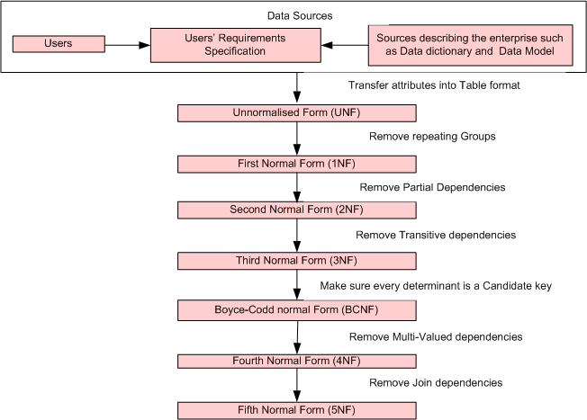
Steps in the Data Normalization Process

Slide 116
Domain Key Normal Form (DKNF)
The relation is in DKNF when there can be no insertion or deletion anomalies in the database.

Slide 117
Overall Database Design Process
We have assumed schema R is given
R could have been generated when converting E-R diagram to a set of tables.
Normalization breaks R into smaller relations.
R could have been the result of some ad hoc design of relations, which we then test/convert to normal form.

Slide 118
ER Model and Normalization
When an E-R diagram is carefully designed, identifying all entities correctly, the tables generated from the E-R diagram should not need further normalization.
However, in a real (imperfect) design there can be FDs from non-key attributes of an entity to other attributes of the entity
E.g. employee entity with attributes department-number and department-address, and an FD department-number → department-address
Good design would have made department an entity
FDs from non-key attributes of a relationship set possible, but rare --- most relationships are binary

Slide 119
Denormalization for Performance
May want to use non-normalized schema for performance
E.g. displaying customer-name along with account-number and balance requires join of account with depositor
Alternative 1: Use denormalized relation containing attributes of account as well as depositor with all above attributes
Faster lookup
Extra space and extra execution time for updates
Extra coding work for programmer and possibility of error in extra code
Alternative 2: use a materialized view defined as account depositor
Benefits and drawbacks same as above, except no extra coding work for programmer and avoids possible errors

Slide 120
End of Presentation

